Slide 1
Cloud on Cloud
Cloud Computing with Big Data
Group 2 WAFFLE-RUSH
XU RUIKANG, LIANG WENJIE, JIANG GUANYU, SHEN YIPENG
2024 NUS SWS

Slide 2
Road Map
Introduction
Service and functionalities
Tech issues
Summary

Slide 3
Introduction
Background & Visions

Slide 4

Introduction
background
14 cities
billions of properties
27 lives
Figure 1 : The devastating impact of a climate disaster

Slide 5
Introduction
background
climate disasters
common & powerful
The living mechanism…
information
scattered
responses
slow

Slide 6
Introduction
visions
What’s the tool about?
weather informing and forecasting…
creating a community…
collaborating, preparation-making, resources-sharing and life-saving

Slide 7
Service and functionalities
Let’s meet Cloud on Cloud.

Slide 8
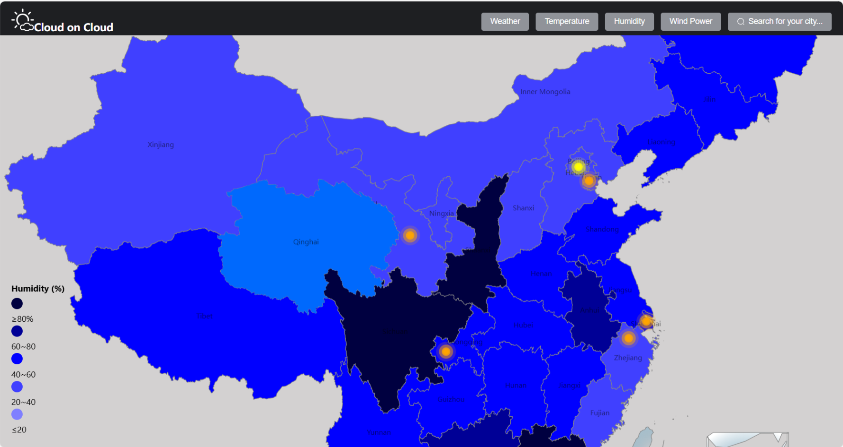
Service and functionalities
weather information service

Slide 9
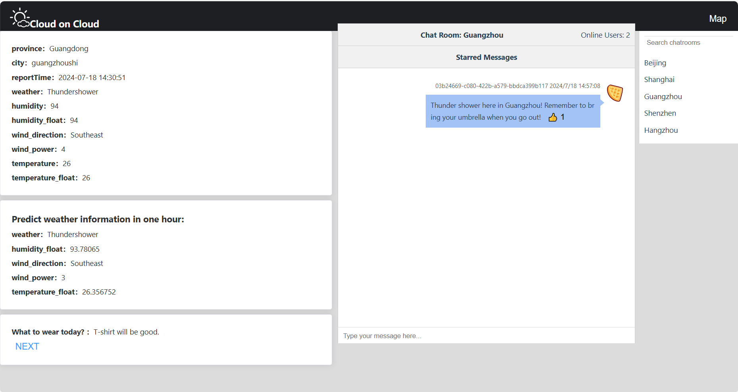
Service and functionalities
weather information service

Slide 10
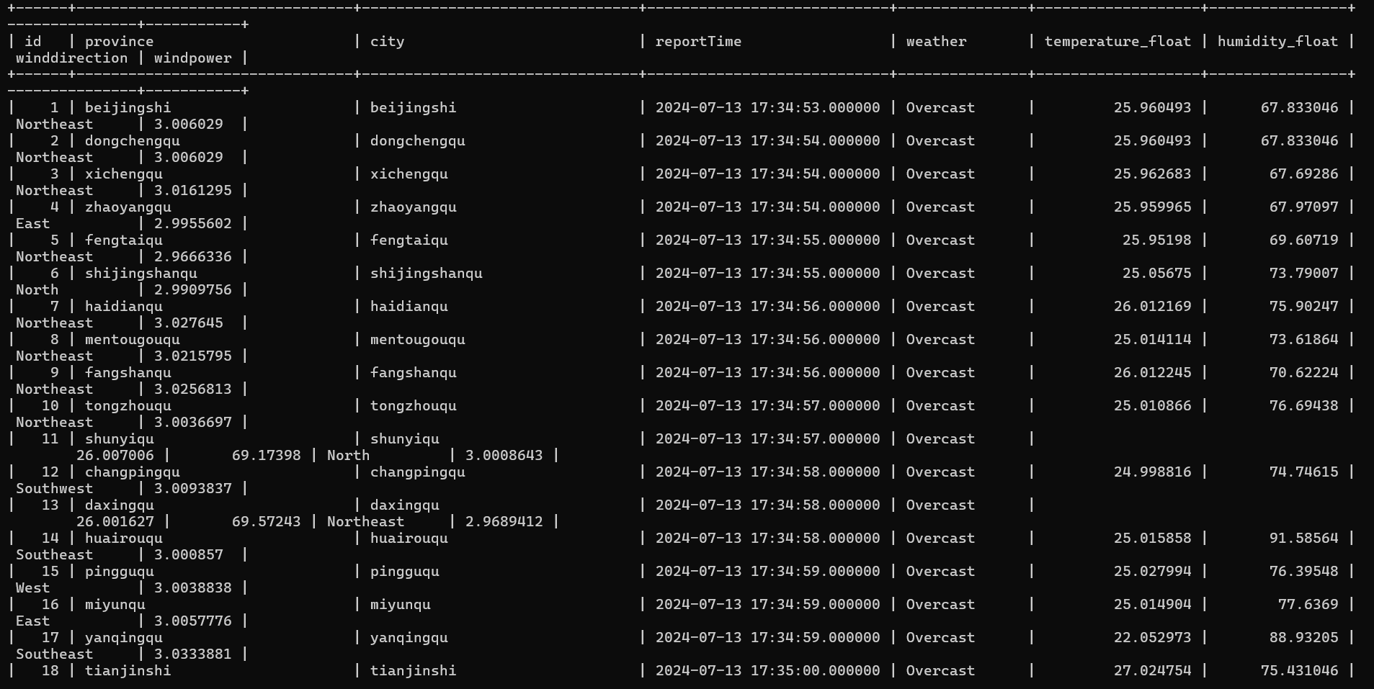
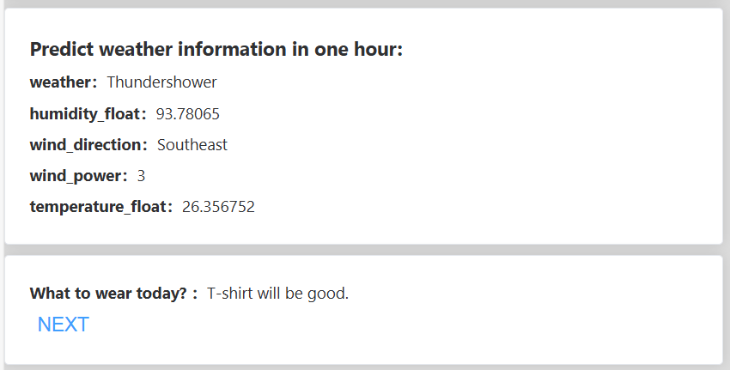
Service and functionalities
weather prediction service
LSTM : The real hero!

Slide 11
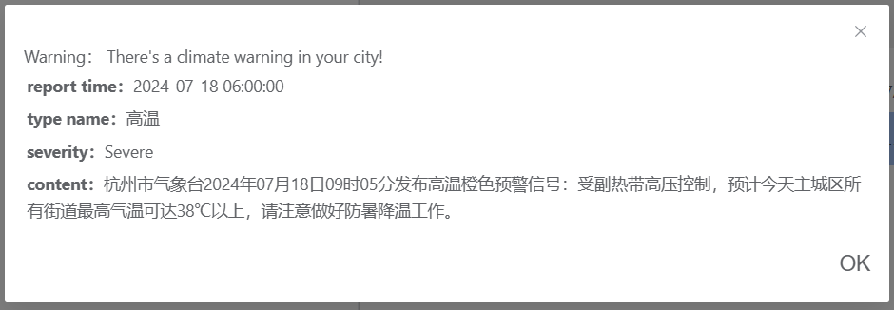
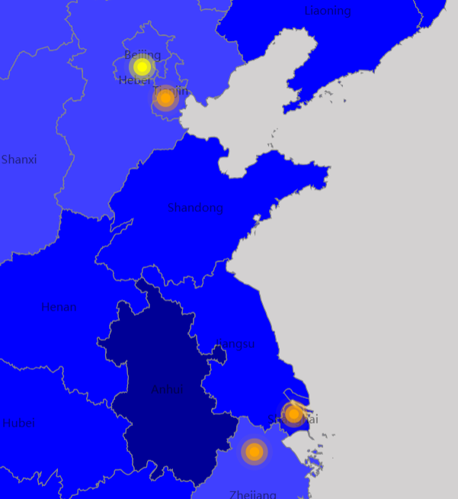
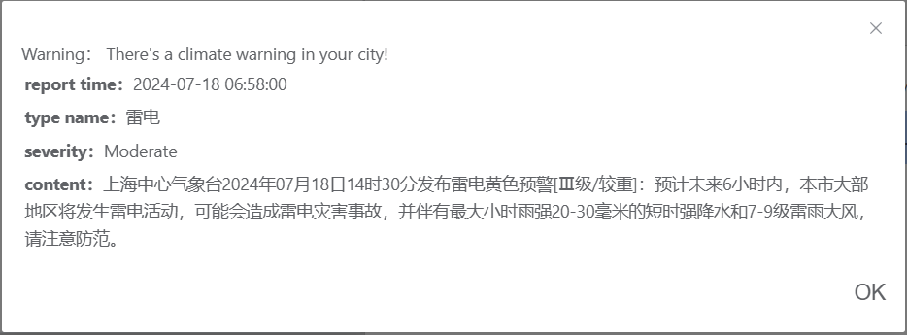
Service and functionalities
disaster warning service

Slide 12
Service and functionalities
hands-on experience
Now, I need your help…
Get into our website.
(You can find the url at https://github.com/lonilow/SWS.git)
Search for city : Beijing
Find my message about weather in “Beijing” channel.
Click “like” for my message!

Slide 13
Tech issues
Kubernetes, cloud
and lessons

Slide 14
Tech issues
Our tech stack
— Containerization: Docker
— Orchestration: Kubernetes
— frontend：Vue
— backend：python native & python+django &
java native
— database：MySQL
— input filter：Chatgpt 3.5 turbo
— info source: GaoDe Map

Slide 15
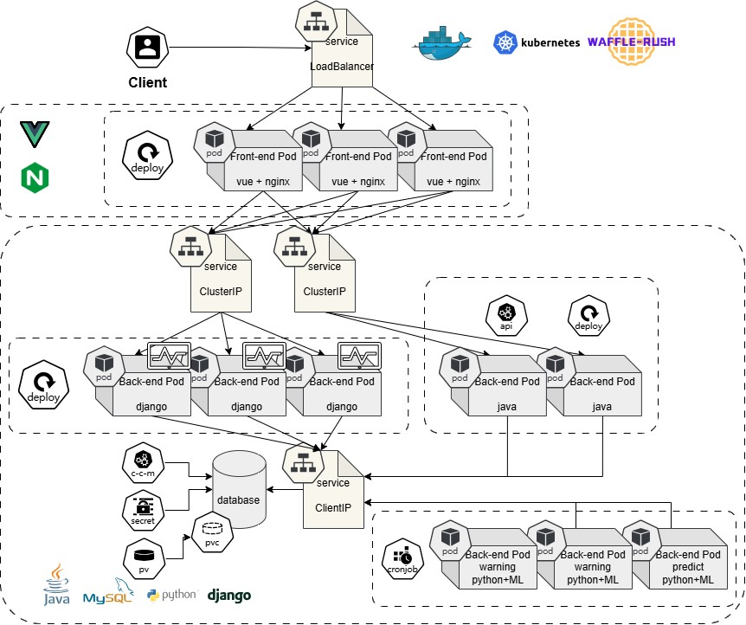
Tech issues
Kubernetes Architecture
Micro Service
Economical
Diagnosability
Figure 2 : The architecture of our kubernetes cluster.

Slide 16
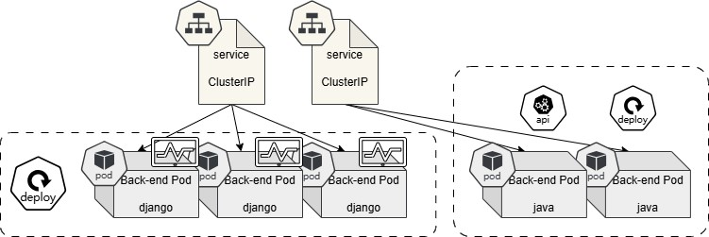
Tech issues
Micro Service
Figure 3 : backends using different programming languages and frameworks
single responsibility
light communication
faster development

Slide 17
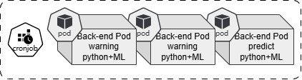
Tech issues
Economical
30min
batch processing
repeated
work for 10 min -> idle for 20 min!
a declarative way to manage pod lifecycle
Figure 4 : the cronjob manages pods

Slide 18
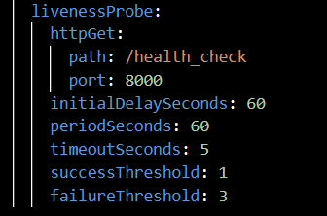
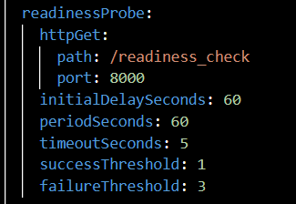
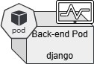
Tech issues
Diagnosability
Figure 6 : two kinds of probes
livenessProbe
Ensure Low Latency

Slide 19
Tech issues
Kubernetes Architecture
Micro Service
Go Cloud Native For
Capability
Economical
Diagnosability

Slide 20
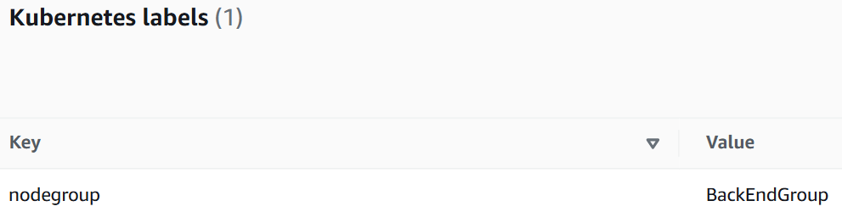
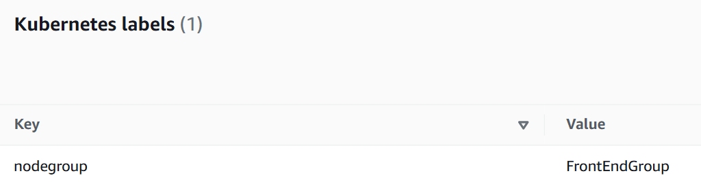
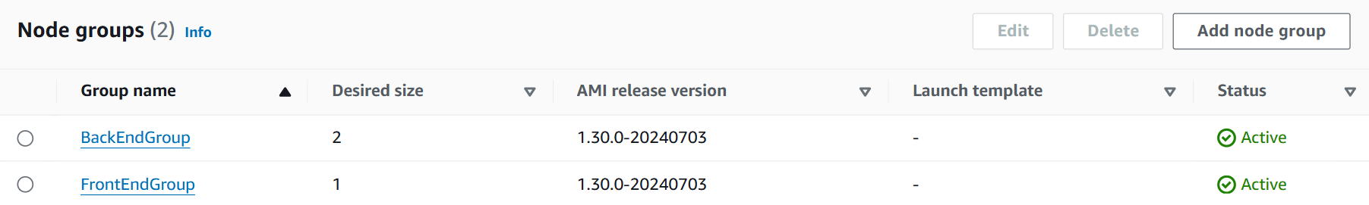
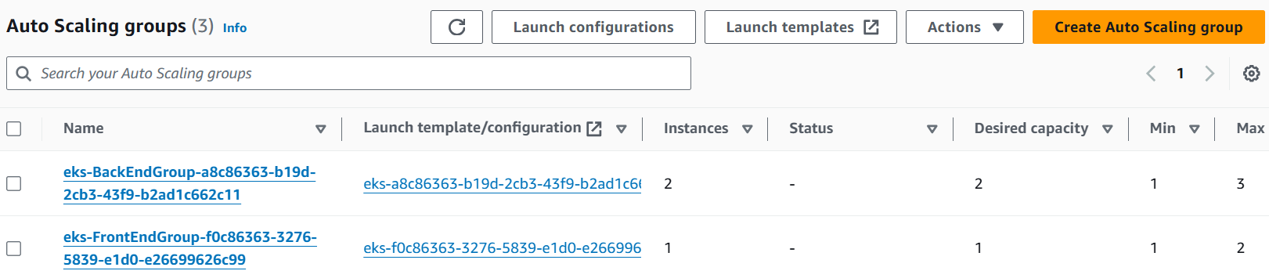
Tech issues
Elasticity
Auto-Scaling-Group &
HPA (HorizentalPodAutoscaler)

Slide 21
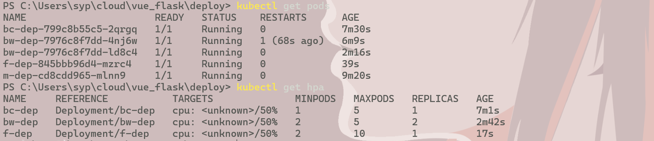
Tech issues
Elasticity
Auto-Scaling-Group &
HPA (HorizentalPodAutoscaler)

Slide 22
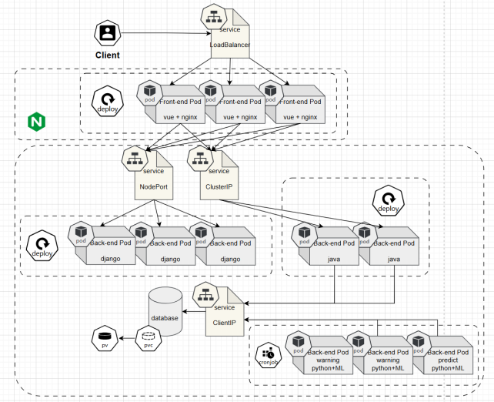
Development process
The traits of cloud-native
Migratability & Elasticity & Encapsulation
Developing Model V.S. Production Model
Functionality disassembly & front/backend separation
Parallel framework-building & function-developing

Slide 23
Try a lot + Fail a lot = Learn a lot + Inelegant solution
It’s indeed a good try to seeks for proven solutions of others at last —— Nginx with reverse proxy
Development process
Give it a try ?
Directly call the service x
—— Difference between serve/build – problem with parsing static files ‘dist’
Directly call the dns x
—— Inflexible url modification – ENV – js server can’t read local env due to security
Side-car designation x
—— One pod with two containers – side part create a localhost listening & forwarding server
Works in local √ Works in pods with flask + flask √ fails in pods with vue + flask
One container, Two program ?
—— However it doesn’t seems a better way

Slide 24

Tech issues
Kafka
Our Trial:
Why do we want to use it?
Weather data needs to be updated in real-time
The amount of weather data is enormous
Ensure accuracy and stability
Lower cost, higher efficiency
Display the dynamic changes in temperature of a certain place since the records began in the past in a short time
The received data is discontinuous “compress”time series to make it “continuous”

Slide 25
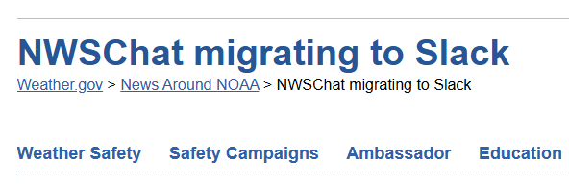
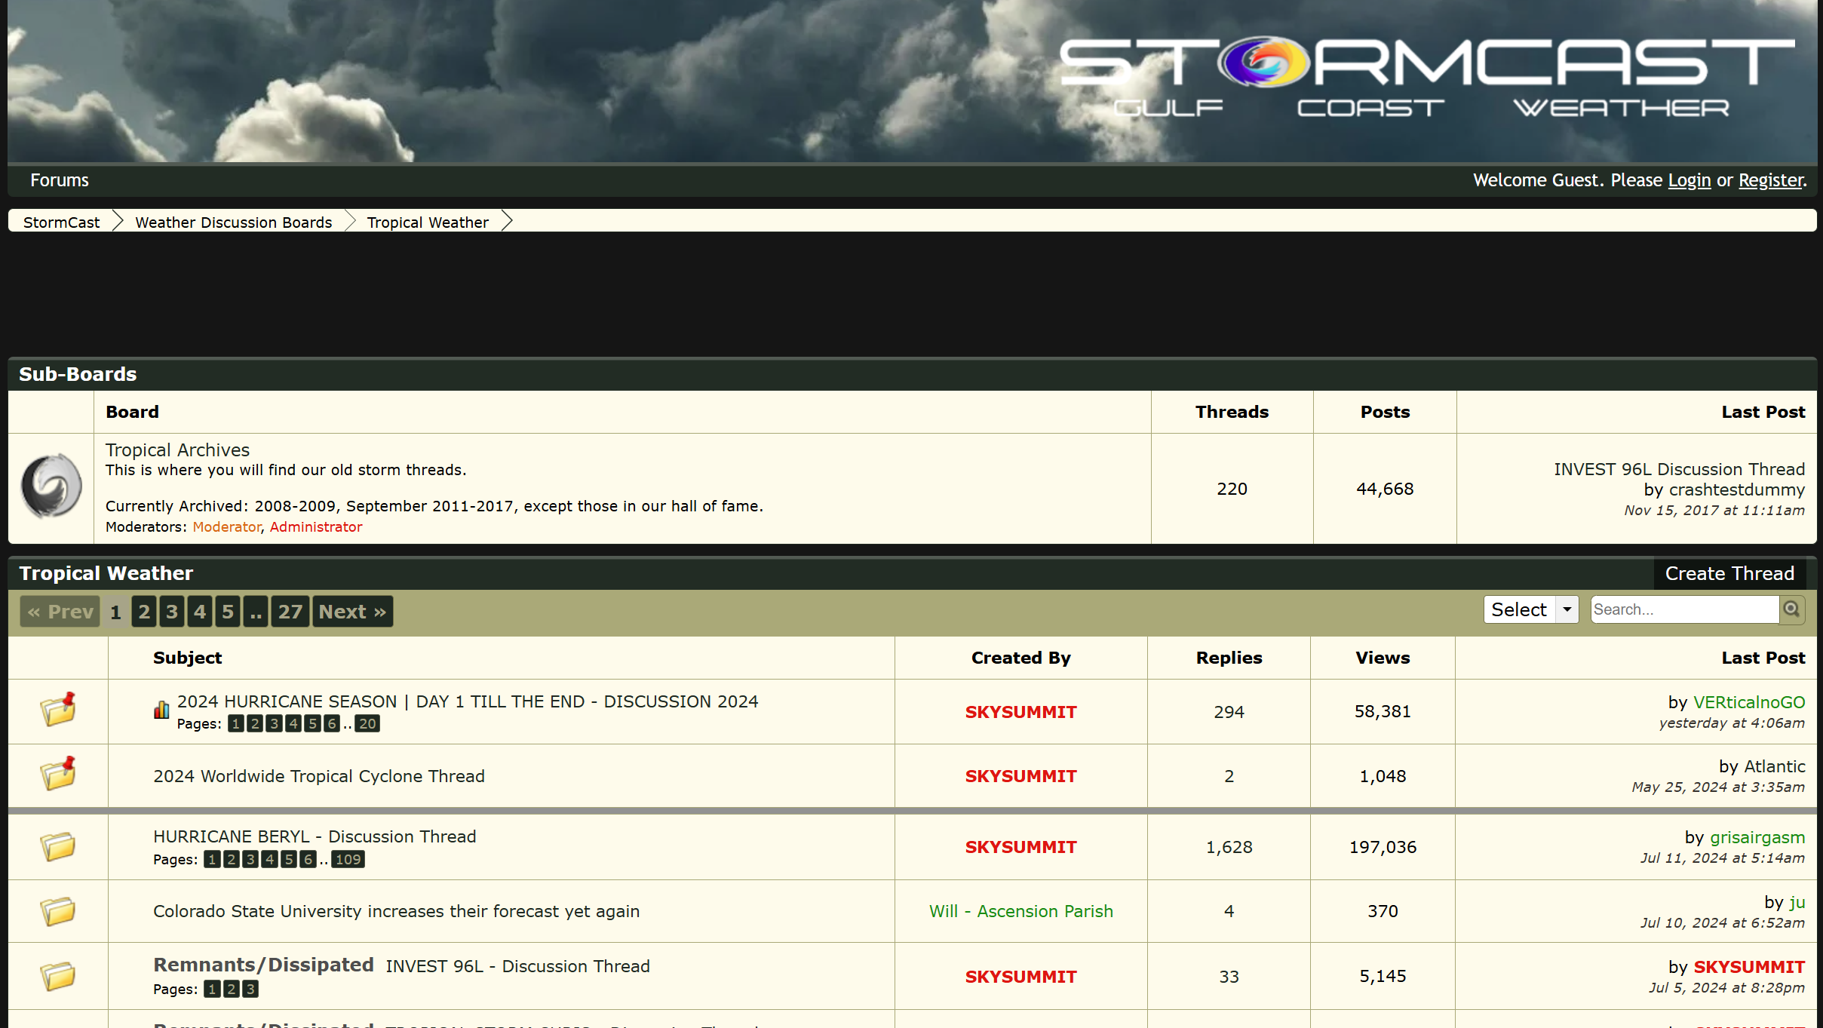
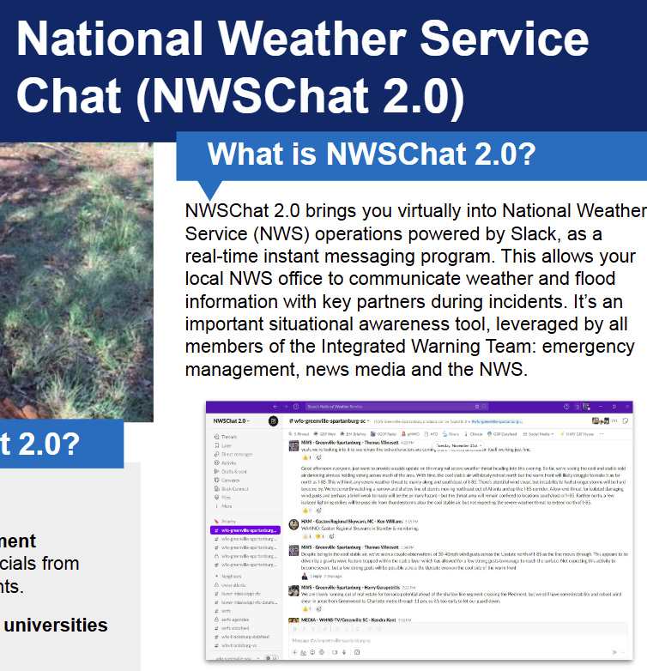
Tech issues - Chatroom
Why we want to build a chatroom? - Real needs & better solutions
NWSChat
STORMCAST
High threshold
Only available to professional weather-relative officials.
Performance requirements
Migrated to Slack - Emergency of improving reliability, security and expand functionality.
“Half-realtime”
The format of the forum makes replies lose timeliness.

Slide 26
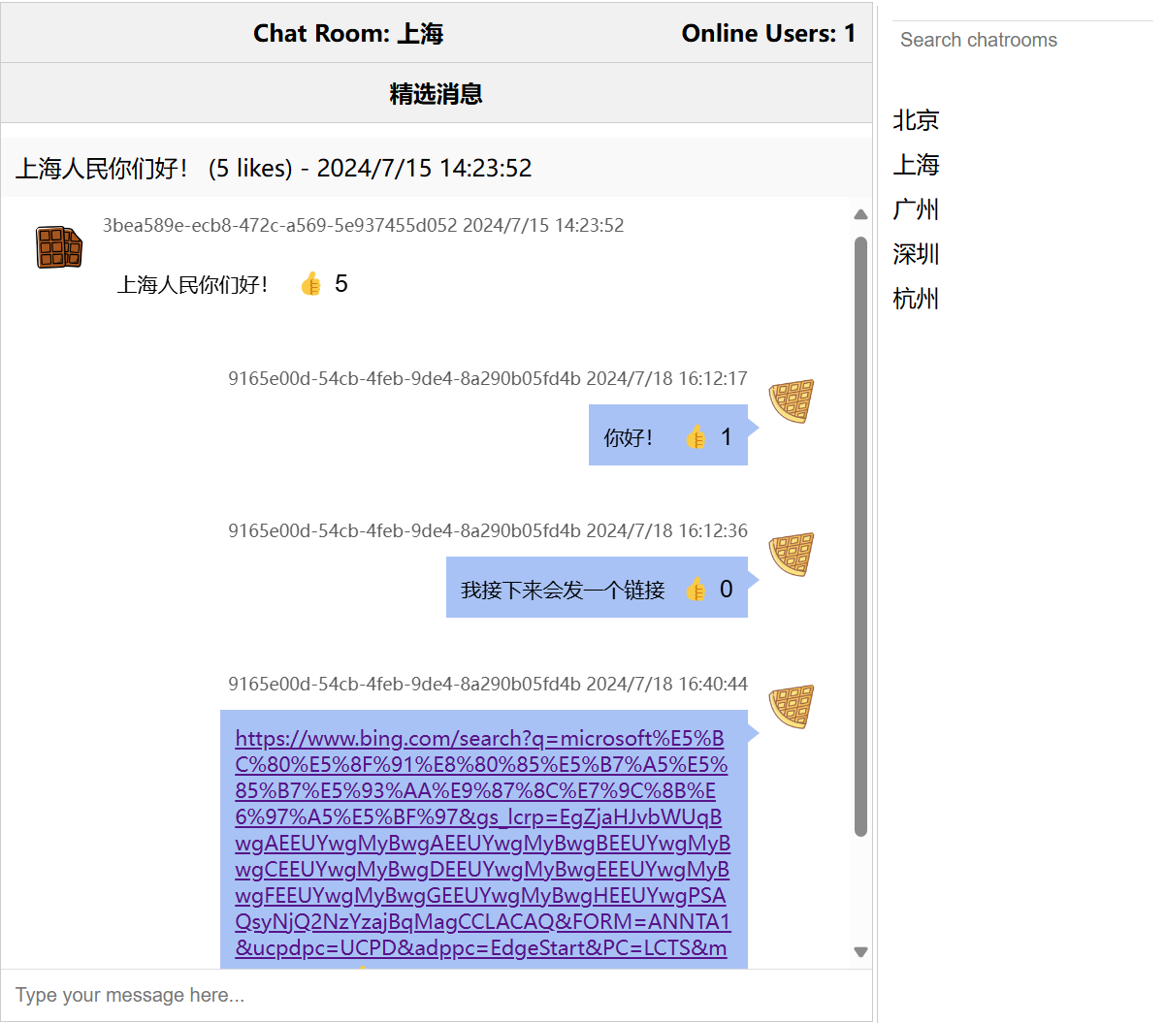
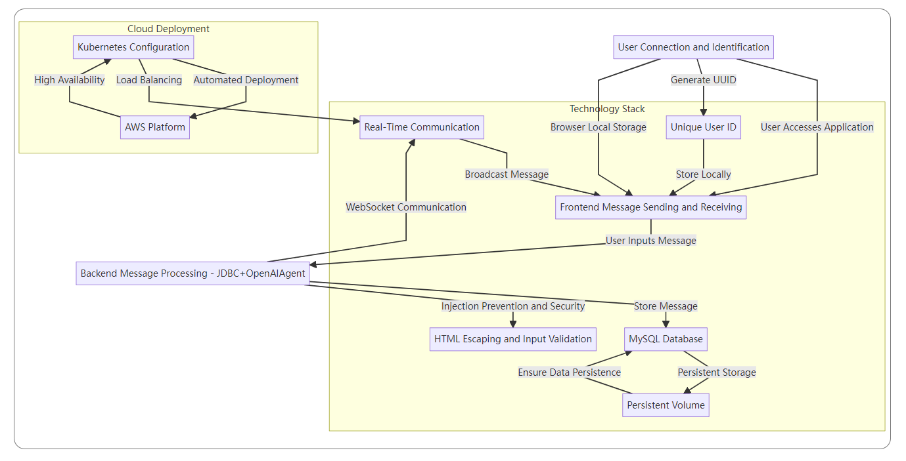
Tech issues
The workflow of chatroom
Backend - Java + spring boot / OpenAI Agent
DB - JDBC + MySQL
Protocol - Websocket

Slide 27
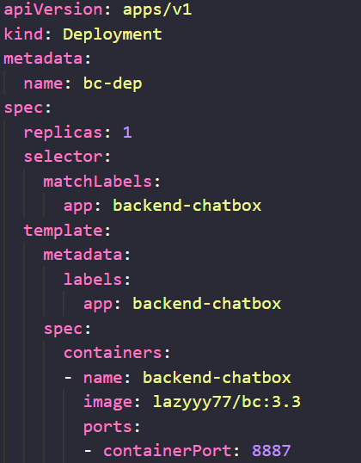
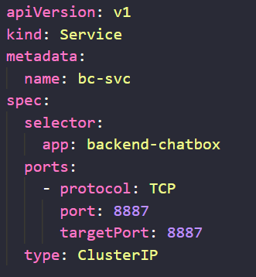
Tech issues
The deployment of chatroom
bcdep.yaml
bcsvc.yaml

Slide 28
Tech issues
How it fits the cloud environment?
Elastic Expansion:
Automatically scales resources based on load, preventing performance bottlenecks during user surges.
High Availability:
Ensures system reliability through multi-copy deployment and load balancing, maintaining normal operation even if nodes fail.
Convenient Management:
Simplifies application deployment, monitoring, and maintenance with automated Kubernetes functions.

Slide 29
Summary

Slide 30
Summary
Innovation and potential
Based on a real need!
A combination of weather and a chat room.
Using cloud tech to make app more capable.
…
our way of using technology to
make a difference

Slide 31
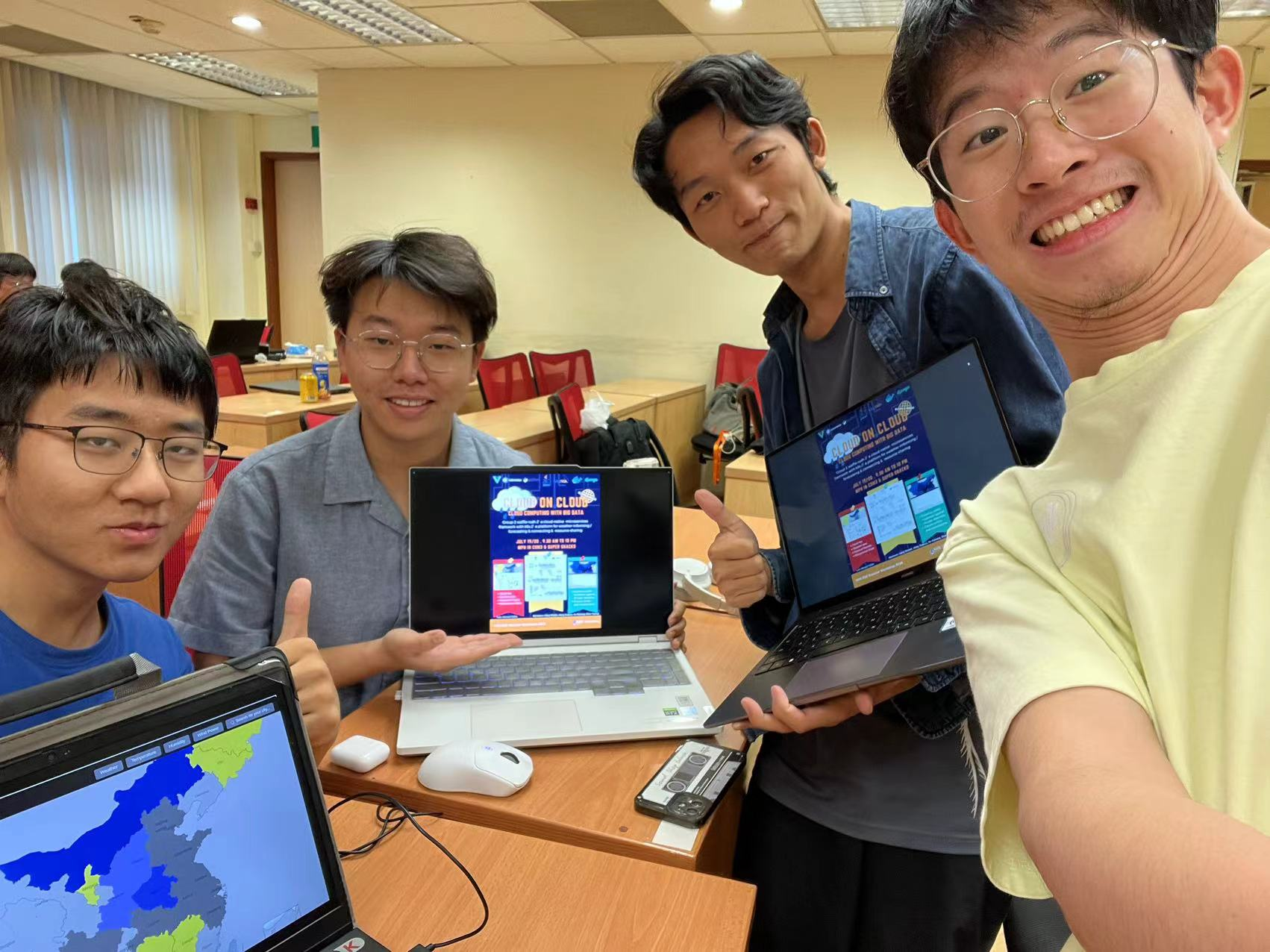
Our Team
Shen Yipeng
Jiang Guanyu
Xu Ruikang
Liang Wenjie
Figure ? : the photo of our team

Slide 32
Acknowledgement

Slide 33
Q & A

Slide 34
THANK YOU

